Slide 1


Department of Computer Science and Engineering
CS191P11 –IOT
SMART IOT EGG
INCUBATOR
PRADEEP KUMAR S -230701230 RAHUL P-230701254

Slide 2
ABSTRACT
This project presents the design and implementation of a Smart IoT-Based Egg Incubator that leverages IoT technology to automate and monitor the incubation process. The system is built around an ESP32 microcontroller, which manages various components including a DHT11 sensor for real-time monitoring of temperature and humidity. A relay module controls an AC motor to rotate the eggs at regular intervals, simulating natural incubation. A high-intensity LED is used as a heating element, providing the necessary warmth to maintain optimal incubation temperature. To prevent overheating, a DC fan is activated when the temperature exceeds a predefined threshold, ensuring a stable environment. The system also features a notification mechanism that alerts users immediately when temperature levels go beyond safe limits. By automating the incubation process and enabling remote monitoring, this IoT-enabled incubator enhances hatch rates, reduces manual dependency, and promotes efficiency in poultry farming practices.

Slide 3
Introduction
In the evolving domain of modern agriculture, particularly in poultry farming, maintaining precise environmental conditions during the incubation process is crucial for ensuring high hatchability and healthy embryo development.
With the advent of Internet of Things (IoT) technology, a new paradigm of intelligent automation and real-time monitoring has emerged, offering advanced solutions to overcome traditional challenges in incubation management. The integration of IoT-enabled sensors and microcontrollers allows for continuous tracking of environmental conditions, timely notifications of deviations, and autonomous control of heating and cooling mechanisms. These capabilities significantly enhance the reliability, consistency, and efficiency of the incubation process.

Slide 4
Problem Statement
Traditional egg incubation methods often rely on manual monitoring and control, which can lead to inconsistent conditions and reduced hatch rates. Inaccurate temperature or humidity levels, irregular egg turning, and lack of timely intervention can significantly affect the success of the incubation process. The proposed solution is an intelligent system that continuously monitors environmental conditions, ensures timely egg rotation, and alerts the user when deviations occur—helping to maintain optimal incubation settings and improve efficiency in poultry farming.

Slide 5
Proposed Work
The proposed system is a smart egg incubator using IoT technology to monitor and control temperature. A DHT11 sensor measures temperature, and an ESP32 microcontroller sends data in real-time. If the temperature crosses a set limit, a Telegram bot sends an alert to the user. A relay module controls an AC motor for egg turning, a DC fan for airflow, and an LED light for internal lighting. This system ensures proper hatching conditions with minimal manual effort.
This system reduces manual intervention and ensures a stable environment for egg incubation. It is cost-effective, easy to use, and ideal for small-scale poultry farmers or educational setups. Future improvements may include additional sensors and AI-based temperature prediction for smarter automation.

Slide 6
Implementation
A DHT11 sensor is connected to the ESP32 microcontroller to continuously monitor the incubator's internal temperature. The sensor data is read at regular intervals to ensure real-time accuracy.
The ESP32 is programmed using Arduino IDE to process sensor data, compare it with threshold values, and control outputs. It also manages the communication with the Telegram bot.
A 4-channel relay module is used to control the AC motor, DC fan, and LED light. Based on the sensor readings, these components are activated or deactivated to maintain ideal incubation conditions.
When the temperature exceeds the safe range, the ESP32 sends a message via a Telegram bot API. This alert reaches the user instantly, enabling quick intervention if necessary.

Slide 7
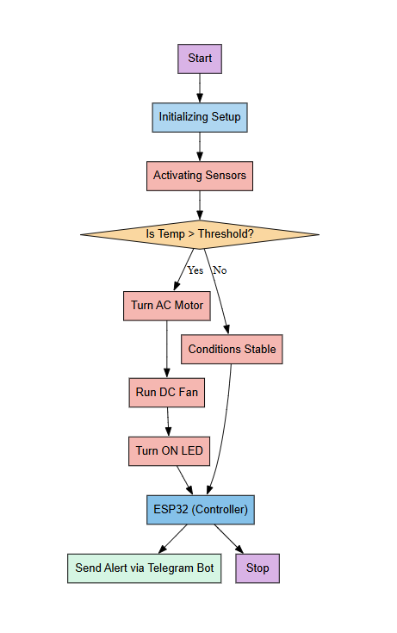
Architecture

Slide 8
System requirements
ESP32
DHT11 / DHT22 Sensor
4-Channel Relay Module
AC Motor
DC Fan
LED Light
Jumper wired

Slide 9
Advantages of the proposed system
Sends instant Telegram notifications when the temperature goes beyond the safe limit
Automatically controls motor, fan, and light to maintain ideal hatching conditions.
Minimizes the need for constant human monitoring and manual egg turning.
Maintains consistent conditions, which increases the success rate of hatching.
Uses affordable components and can be easily scaled or improved in the future.

Slide 10
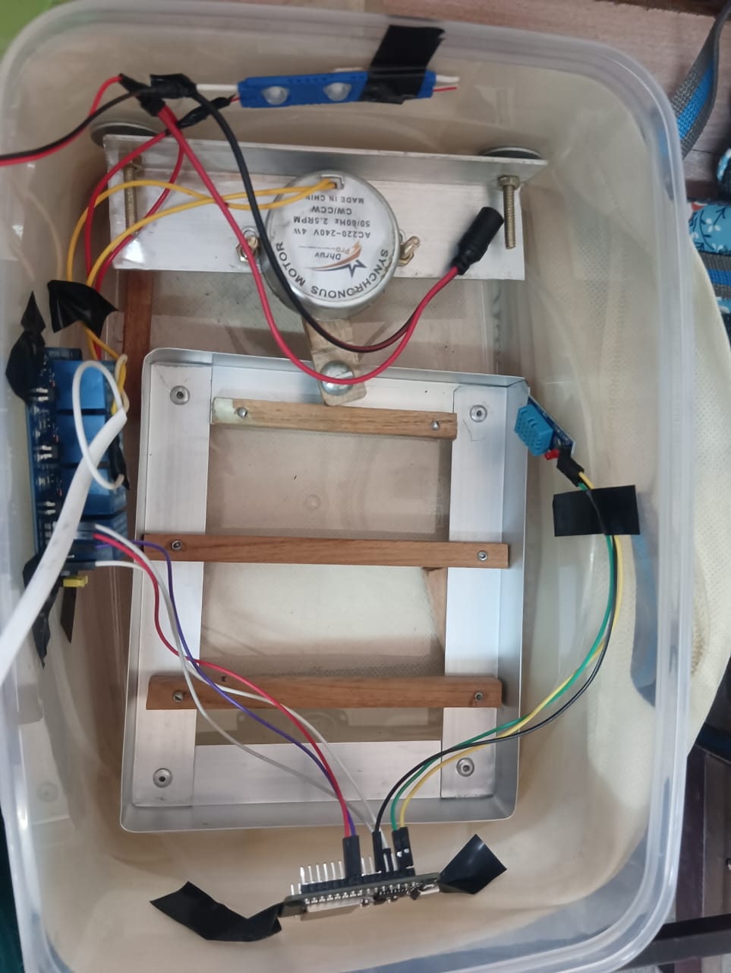
Smart Shoe

Slide 11
Implementation of Incubator
A DHT11 sensor is connected to the ESP32 to measure the temperature inside the incubator at regular intervals.
The ESP32 is programmed using Arduino IDE to read sensor data, check against threshold values, and control devices accordingly.
A 4-channel relay module is used to operate the AC motor (for egg turning), DC fan (for air circulation), and LED light (for lighting or heating support).
An LED light is used to assist in maintaining optimal temperature or providing visibility inside the incubator.

Slide 12
Implementation of Incubator
The AC motor is activated at set time intervals to rotate the eggs automatically, mimicking a hen’s behavior.
When temperature exceeds a predefined limit, the ESP32 uses Wi-Fi to send real-time alerts to the user through a Telegram bot.
The entire system is tested under real conditions, and thresholds are calibrated to ensure accurate and reliable incubation performance.

Slide 13
Conclusion
The IoT-based smart egg incubator system provides an efficient, automated, and reliable solution for egg hatching. By integrating temperature monitoring, real-time alerts through Telegram, and automatic control of essential components like the AC motor, DC fan, and LED light, the system ensures a stable and ideal environment for incubation. This reduces the need for manual supervision and improves the chances of successful hatching. Overall, the system is user-friendly, cost-effective, and highly beneficial for small-scale poultry farmers and educational purposes.

Slide 14
References
[1] Chougule, S. M., Desai, V. B., Gaikwad, P. S., Kamble, S. S., & Metkari, V. T. (2021). Smart Egg Incubator. International Journal of Advance Scientific Research and Engineering Trends, 6(6), 72-75. DOI: 10.51319/2456-0774.2021.6.0018.
[2] KONE, T., ANOH, N. G., YATANAN, B. G., BROU, Y. A. A., AHOUTOU, N. J., & ALLOU, J. D. (2024). Design and Development of an IoT-Based Intelligent Incubator. Journal of Engineering and Technology, 9(1), 3396-3401. DOI: 10.47191/etj/v9i01.21.
[3] Jafni Bin Wan Ahmad Jaffry, W. H., & Othman, N. E. B. (2024). Development of Egg Hatcher with the Application of the Internet of Things (IoT). Proceedings of the International Conference on Innovation & Entrepreneurship in Computing, Engineering & Science Education (InvENT 2024), Advances in Computer Science Research, 117, 188-197. DOI: 10.2991/978-94-6463-589-8_19.

Slide 15
Thank You

